Slide 1

Restaurant Order Analysis
By: Sahnawaj Ahmed

Slide 2
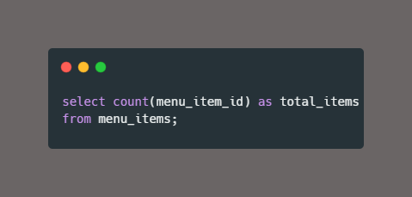

View the menu items table and write a query to find the number of items on the menu

Slide 3
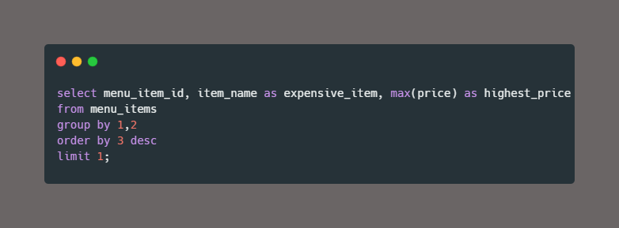

What are the most expensive items on the menu?

Slide 4


What are the least expensive items on the menu?

Slide 5
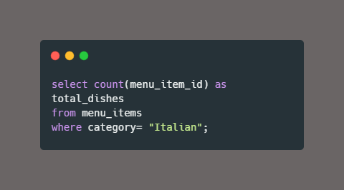

How many Italian dishes are on the menu

Slide 6
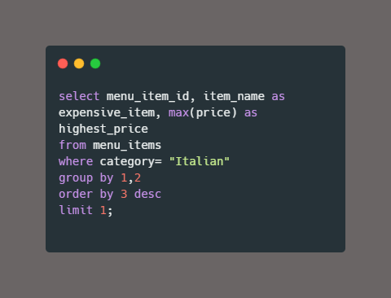

What are the most expensive Italian dishes on the menu?

Slide 7
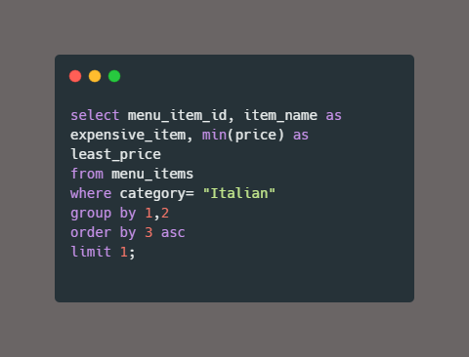

What are the least expensive Italian dishes on the menu?

Slide 8
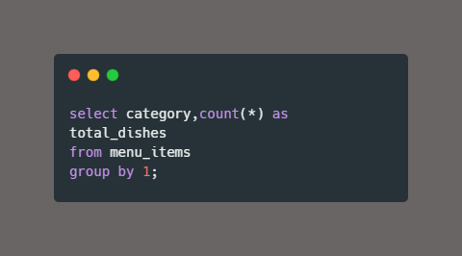
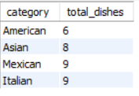
How many dishes are in each category? What is the average dish price within each category?

Slide 9
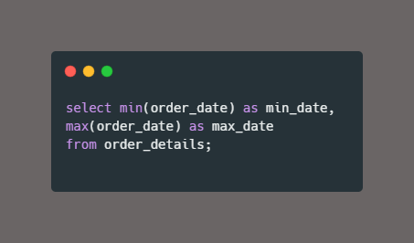

View the order details table. What is the date range of the table?

Slide 10
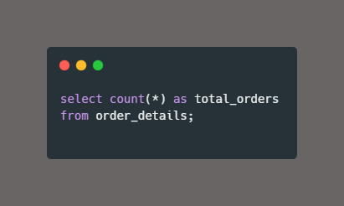

How many orders were made within this date range? How many items were ordered within this date range?

Slide 11
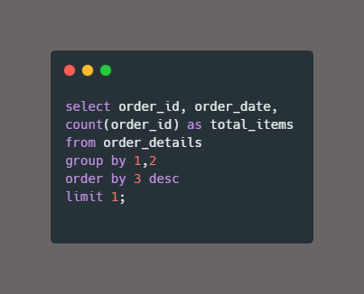

Which orders had the most number of items?

Slide 12
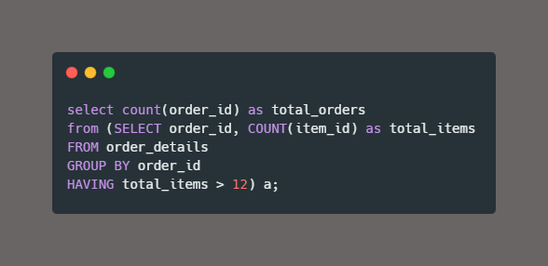

How many orders had more than 12 items?

Slide 13
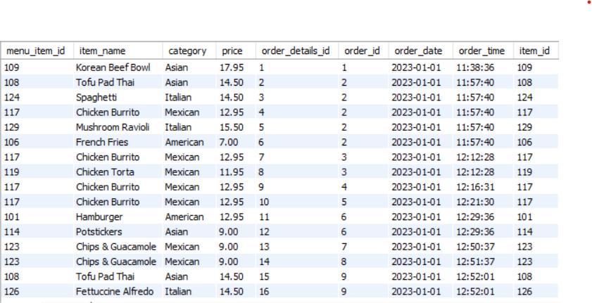
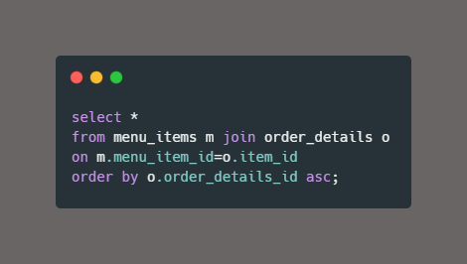
Combine the menu items and order details tables into a single table

Slide 14
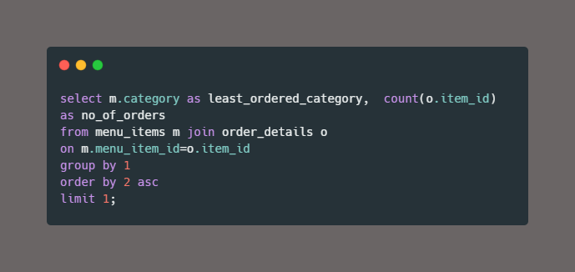

What were the least ordered items? What categories were they in?

Slide 15
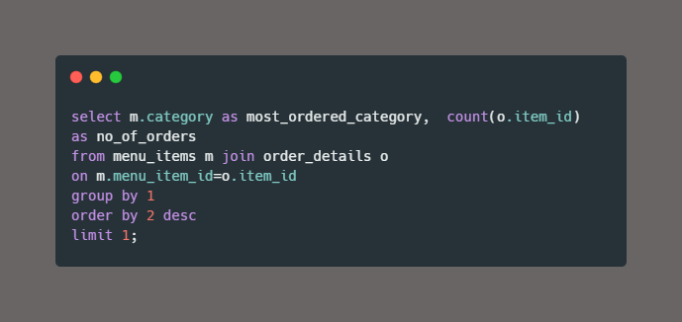

What were the most ordered items? What categories were they in?

Slide 16
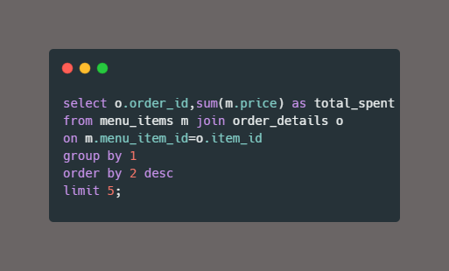
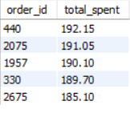
What were the top 5 orders that spent the most money?

Slide 17
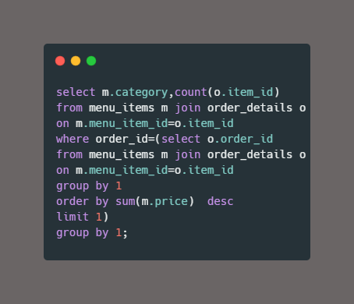
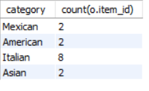
View the details of the highest spend order. Which specific items were purchased?

Slide 18
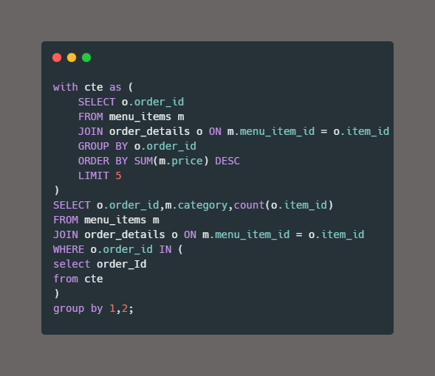
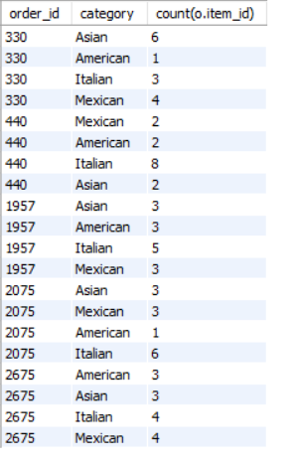
View the details of the top 5 highest spend orders

